Slide 1
Financial aid Dual Credit
Christina Palacios
Coordinator of Student Financial Aid Services
Christina.palacios@tccd.edu
817-515-1058

Slide 2
Process
Complete a FAFSA at www.studentaid.gov
Provide additional documentation if selected for the verification process
This will be found via MyTCC Track in “Financial Aid”
Check my.tccd.edu email frequently
Complete Dual Credit Enrollment Grant Application
If you wish to receive fall and spring awards, select both boxes
Awarded for up to six credit hours per semester: Tuition $384, Books $400 (each semester)
Award is based on in-county tuition rates
Funds are limited and awarded on a first-come-first-serve basis
Complete Selective Service Registration Form
Select box that best describes you
Complete signature section and return with Dual Credit Enrollment Grant Application
Funds will not be awarded until the selective service form has been submitted

Slide 3
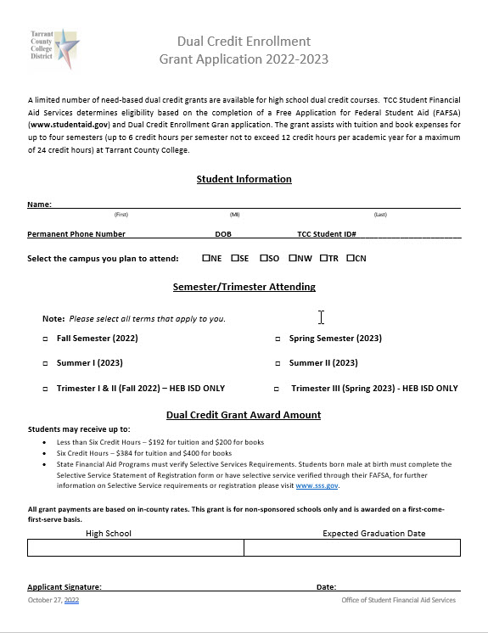
Dual Credit Enrollment Grant Application 2021-2022

Slide 4
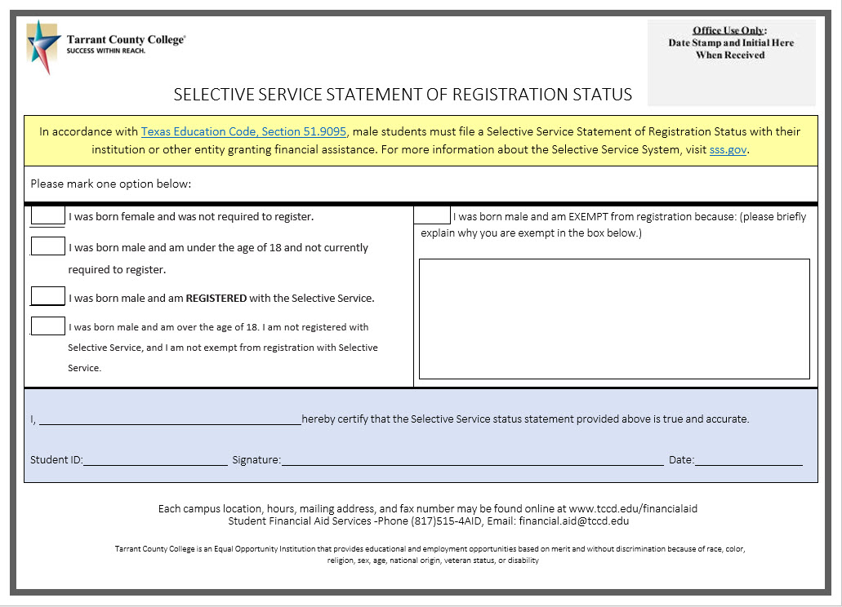
State Requirement

Slide 5
Helpful tips
Ensure all documents are signed and have TCC Student ID
Verify that students' social security number is correct with Admission & Records
Must have a FERPA Waiver on file if Parents wish to inquire about student records
Apply Early

Slide 6
Questions?

Slide 7
Advising & Counseling Center
Andrew Hill, MA, LPC
Director Advising and Counseling Center
Office: 817 515 4742 | andrew.hill2@tccd.edu

Slide 8
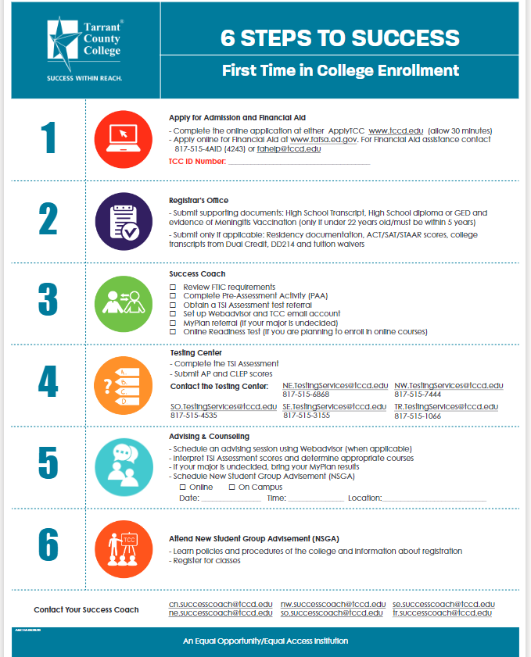
First-Time-In-College Center
Success Coach and Enrollment Coach
Review FTIC requirements
Complete the Pre-Assessment Activity (PAA)
Obtain a TSI Assessment referral
Set up your WebAdvisor and TCC email accounts
Create a MyPlan referral (if your major is undecided)
Take the Online Readiness Test (if you’re enrolling in any online courses)
Coordinate First Year Experience Program
Student Success Workshops
Learning community engagements
Notes:
I plan to use a ftic powerpoint. Adriana, Shawn & Donna

Slide 9
Advising and Counseling Center
Academic Advisor
Counselor
Review TSI Assessment placement scores and determine which courses will work best for semester schedule
Help select courses
Learn about transferring to a 4-year university
Explore career options and resources
Find various campus services like tutoring, academic help, and more
Counseling- Currently, our counselors are not able to offer ongoing counseling sessions with any student under the age of 18. We will refer all requests for counseling from minor students back to the High School Counselor.
Crisis- If a student is in crisis on campus our counselors can address the crisis but cannot see them on an ongoing basis.
Mental Health Resources- Counselors can provide all students infromation about community mental health resources.

Slide 10
Academic Standing
The Importance of Grade Point Average (GPA)
“Good Academic Standing” = 2.0 GPA or higher
“Probation” = lower than 2.0 GPA (Cumulative)
“Suspension” = lower than 2.0 GPA throughout probationary period

Slide 11
Pathways to Academic Student Success (PASS) Program
1. Advisement hold
End of semester
Email sent to student
2. Packet
Letter on PASS process
PASS session Link
Session evaluation
Self-assessment
3. Student contact 817-515-4186 or southpass@tccd.edu
Receive instructions on PASS packet
Schedule or reschedule PASS appointment
4. Complete Packet
Contact student to schedule an individual appointment (in-person or phone)
Note in Superscreen the PASS packet emailed to the student
Note in Superscreen documents was received, and an appointment scheduled with the name of the advisor/counselor
Attach documents to assigned advisor/counselor appointment outlook invite

Slide 12
Coach and Advisor Liaisons
ISD | School | Campus Coach | Campus Academic Advisor
Crowley | Crowley High School North Crowley High School Crowley Collegiate Academy Crowley P-Tech |  | Cynthia.Dorton@tccd.edu 817-515-4556 David.Carrillo@tccd.edu 817-515-4559
Everman | Everman H.S. Everman ECHS Evermn P-TECH |  | Trisha.Johnson@tccd.edu 817-515-4766
Fort Worth | Dunbar H.S. Dunbar P-TECH O.D. Wyatt H.S. Collegiate Academy @ O.D. Wyatt Polytechnic H.S. Education P-TECH @Polytechnic HS |  | Joan.Gomez-Ghannou@tccd.edu 817-515-1570 Lemarian.Wallace@tccd.edu 817-515-4056 David.Carrillo@tccd.edu 817-515-4559
 | South Hills H.S. P-TECH @ South Hills H.S. |  | Kelly.Greene@tccd.edu 817-515-4289
 | Southwest H.S Southwest Collegiate Academy TCC South Ft. Worth Collegiate Hs Young Men’s Leadership Academy |  | Kelly.Greene@tccd.edu 817-515-4289 Cynthia.Dorton@tccd.edu 817-515-4556 Lemarian.Wallace@tccd.edu 817-515-4056
Private/Charter Schools Kennedale | Harmony School of Innovation |  | Carl.Scherrieb@tccd.edu 817-515-4735
 | Kennedale H.S. |  | Carl.Scherrieb@tccd.edu 817-515-4735

Slide 13
Testing Services
Shawn Taylor-Smith
Testing Coordinator

Slide 14
Testing Services
Testing Services offers:
TSI2.0 - On-campus and Remote Testing
CLEP
ALEKS PPL
MEPT (ESL/ESOL)
GED
ELASSI
Note* Students will need to schedule an appointment for on- campus or remote testing through Register Blast.

Slide 15
Important Information about the TSI TSIA1.0 and TSIA2.0 are valid for 5 years from the test date. Access to all TSIA2.0 Resources (including recorded training) is located on the Accuplacer home page.
Testing Services (cont’d)
Pre-Assessment Activity (PAA)
Students must complete the Pre-Assessment Activity before taking the TSI2.
Primary ID and Supplemental ID
If students are testing at Tarrant County College;
Primary ID- Local IHE number (e.g., TCC Student ID)
Supplemental ID- Texas (TSDS) Unique 10-digit number
If students are testing at their High School for and want to attend Tarrant County College;
Primary ID- Texas (TSDS) Unique 10-digit number
Supplemental ID- Local IHE number (TCC Student ID number)

Slide 16
Testing Services (cont’d)
3 options for Score Sharing :
Accuplacer Student Portal- students can visit tsia2.accuplacer.org to review their score report(s) and email or share their reports with TCC.
Student Shared Individual Score Report-students can send up to 3 free reports to any University or College in Texas.
Cross Institutional Report- students can request their scores be pulled from the High school where they originally tested.

Slide 17
South Campus Testing Services
Business Building # Room 2131
SO.TestingServices@tccd.edu
(817) 515-4535
Testing Staff:
Shawn Taylor-Smith
Lorena Guzman
Darlene Mitchell
Stephenia Smith
Yesenia Wilcox
Virginia Woods
Crystal Jones

Slide 18
Business Services
11/11/22
Presented by Tiffany Rodriguez, Manager of Business Services

Slide 19
Topics
Payment Deadlines
Payment Plans
Other Payment Options
Refunds
Q & A

Slide 20
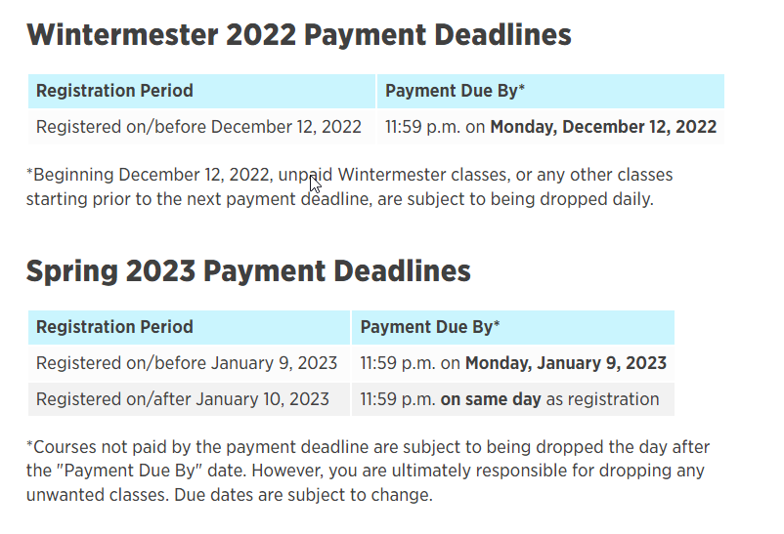
Payment Deadlines
Please visit our website to stay informed: www.tccd.edu > Pay For College > Payment Deadlines
Spring 2023 Tuition is due Monday, January 9, 2023 (Wintermester classes due Monday, December 12, 2022)

Slide 21
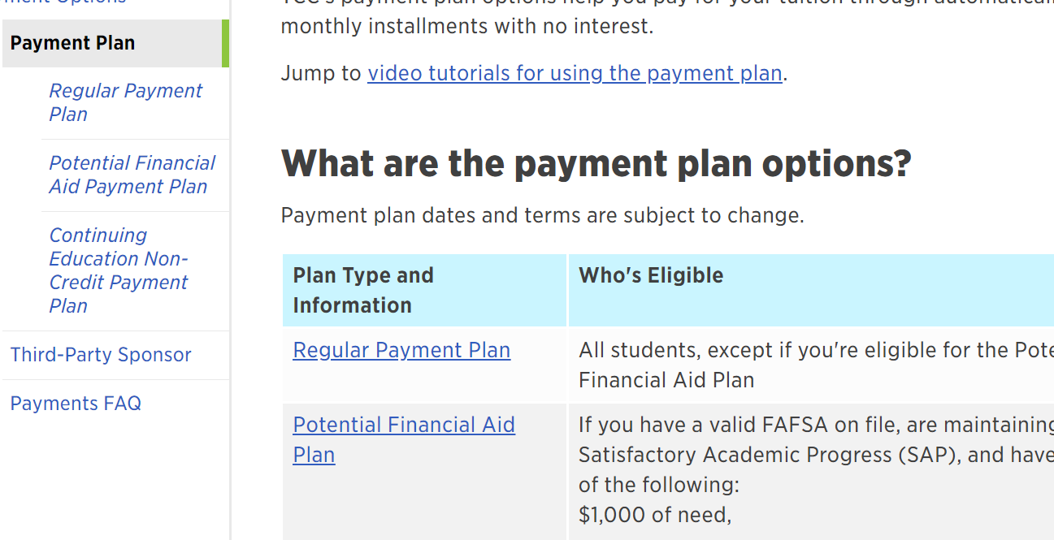
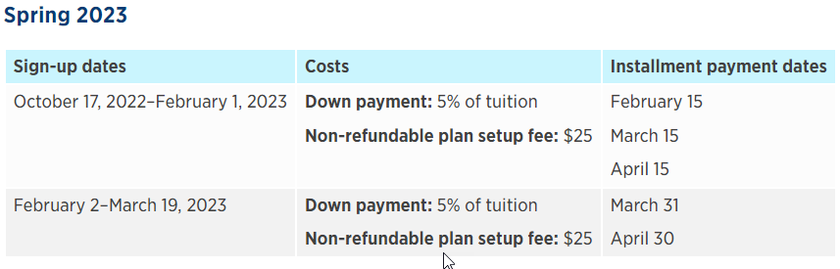
Payment Plans
Our 2023SP Regular Plan’s are currently available. All of our Payment Plan offerings can be found at: www.tccd.edu > Pay For College > Payment Options > Payment Plan
Payment plans must be setup online using a credit/debit card or electronic check (ACH).

Slide 22
Other Payment Options
Pay in full:
In-person by cash, check, money order/cashier’s check, or credit/debit card.
Online by credit/debit card or electronic check (ACH)
Third-Party Payment: Company, organization, or government entity that is paying student’s tuition. Submit required documents that indicate promise to pay by third-party by payment deadlines.

Slide 23
Bankmobile-Refunds
Students that meet the criteria, will receive a green envelope and receive an email with a personal code.
www.tccd.edu > Pay For College > Refunds

Slide 24
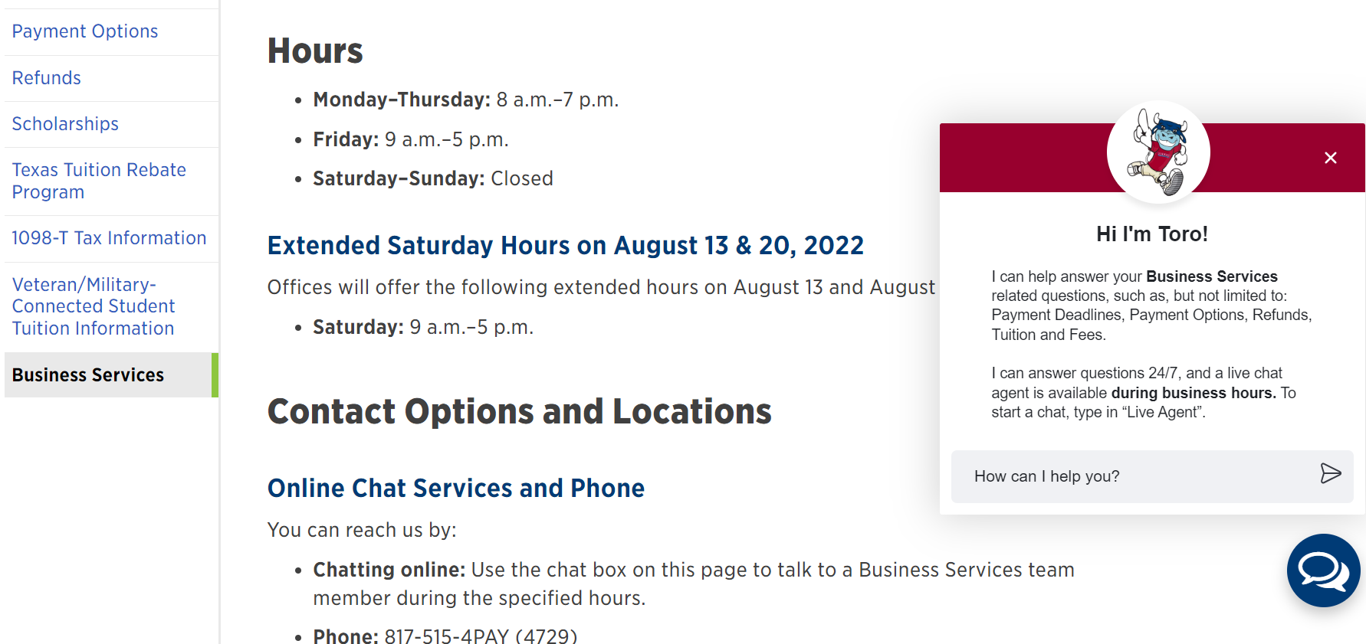
Q & A
Online Chat Services and Phone
You can reach us by:
Chatting online: Use the chat box on any of our Pay for College pages and a Business Services team member will respond during normal business hours.
Phone: 817-515-4PAY (4729)
Be prepared to provide your TCC student ID number.
To follow FERPA guidelines, you may be asked additional security questions to verify your identity before any detailed information is provided.

Slide 25
Closing
On behalf of Business Services,
THANK YOU for giving us an opportunity to share!

Slide 27
Introduction to Libraries Resources
Jenkins Garrett Library,
South Campus
Jennifer Jackson

Slide 28
SEVICES AND RESOURCES
What Services we offer:
Library Instruction (catalog & databases)
TexShare and ILL
LibGuides
A whole lot of other stuff.
.
TCC Device Loan (Students & Adjunct Faculty Only )
Reserves

Slide 29
LIBRARY INSTUCTION
TCC Library Catalog/databases
Use the catalog search to find e-books, streaming video, and more. Database find scholarly articles, newspapers, reviews, etc.
EBOOKS AT TCC
THE TCC LIBRARY HAS AN EXTENSIVE COLLECTION OF EBOOKS AVAILABLE THROUGH THE LIBRARY WEBSITE. LEARN HOW TO ACCESS THEM BY REVIEWING THE GUIDE LINKED ABOVE.
Libguides
ON THIS PAGE, SEARCH FOR LIBGUIDES BY SUBJECT, COURSE, CAMPUS, OR LIBRARIAN.

Slide 30
LIBRARY INSTUCTION
TEXSHARE CARD
CARD ALLOWS STUDENTS, FACULTY AND STAFF AT TCC TO CHECK OUT BOOKS AT COLLEGE AND UNIVERSITY LIBRARIES THROUGHOUT THE STATE.
INTERLIBRARY LOAN (ILL)
ACCESS TO MATERIALS NOT IN OUR COLLECTION. IT’S Solely for faculty and staff
TCC Device Loan Program
ADJUCT FACULTY AND STUDENTS CAN BORROW DEVICES FROM THE LIBRARY.

Slide 31
RESOURCES
reserves
CALL: (817) 515-4524 OR
EMAIL: RESERVES CORDINAR DEDRA THOMAS AT DEDRA.THOMAS@TCCD.EDU
TCC Tech Support
TCC OFFERS FREE ONLINE TECH SUPPORT 24/7. USE THE LINK TO GET ASSISTANCE
LibAnswers
THIS LINK DIRECTS USERS TO THE LIBANSWERS PAGE OF THE TCC LIBRARY WEBSITE AND INCLUDES FAQ AND HOW TO CONTACT LIBRARY STAFF FOR ASSISTANCE

Slide 32
Contact
Director of Library Services:
Laura McKinnon
817/515/4521 or laura.mckinnon@tccd.edu
Assistant Director of Library Services:
Jennifer Jackson
Humanities Liaison
817/515/4009 or jennifer.jackson@tccd.edu
Public Services Librarian:
Ramon Calhoun
Behavioral and Social Sciences Liaison
817-515-4599 or ramon.calhoun@tccd.edu
Public Services Librarian:
Mariya Hapiy
Mathematics and Natural Sciences Liaison
817-515-4026 or mariya.hapiy@tccd.edu
Public Services Librarian:
Lindzi Hughes
Business and Technology Liaison
817-515-4418 or lindzi.hughes@tccd.edu

Slide 33
Admissions & Registrar
SO.Registrar@tccd.edu

Slide 34
Agenda
Dual Enrollment Timeline
Application
ApplyTCC / ApplyTexas
Additional Documents
Residency
Residency Questionnaire
Additional Documents
FERPA

Slide 35
Welcome to TCC South Campus!
Presented by Tarrant County College Student Accessibility Resources

Slide 36
Guiding Legislation
Section 504 of the Rehabilitation Act and the ADA Amendments Act of 2008
Prohibits discrimination against individuals with disabilities.
Family Educational Rights and Privacy Act
Mandates that student disability documentation is protected information and will be kept confidential unless a release is permitted by the student or by law.
504
ADA
FERPA

Slide 37
Process for Requesting Accommodations
PRE-REGISTRATION
POST-REGISTRATION
Apply to college
Meet with a Success Coach
Request accommodations for TSI
Meet with a college Academic Advisor
Register and pay for classes
Provide SAR with documentation of disability
Fill out Student Request form online
Meet with SAR to discuss accommodation needs
Provide instructor with your accommodation letter

Slide 38
Documentation Guidelines
Documentation must be provided by a licensed or credentialed professional for the area being evaluated within the past 3-5 years
Includes
diagnostic statement describing diagnosis and severity
description of diagnostic criteria, evaluation method, tests and dates of administration
current and past medications, auxiliary aids, assistive devices, support services and accommodations
recommended accommodations and strategies

Slide 39
Accommodations
ARE
ARE NOT
provided to students with disabilities because we know they are facing an uphill struggle and want to make things a little easier for them.
provided in hopes of helping students with disabilities be successful in their academic pursuits.
any adjustment that will assure equal opportunity to rights and privileges of all programs and services offered by a post secondary institution.
provided if – and only if – not having the accommodations in place would mean that the individual with a disability would not have equal access to the educational opportunity involved.

Slide 40
Accommodations
ARE
ARE NOT
Extended time for test
Less distracting environment
Note taking assistance
Assistive technology devices or software
Interpreter for the Deaf
Extended deadlines for assignments or projects
Personal attendants
Changes in the Code of Conduct
Reminders to stay on task or to turn in work
Modifications to curriculum, assignments or tests

Slide 41
Accessibility
Accommodations ensure equal access, not success.
Self-Advocacy:
Know Yourself,
Know What You Need and
Know How to Get It

Slide 42
Student Accessibility Resources
For more information or an appointment
817-515-4554
SO.SAR@tccd.edu

Slide 44
Student Conduct & Prevention Education
Belinda Lopez
Fall 2022

Slide 45
Agenda
Student Conduct
Title IX, and mandated reporting obligations
CARE Team
Prevention Education (DASHH)
Student Emergency Assistance Fund

Slide 46
Student Conduct
APPROACH
Educational, Administrative, Neutral
FOCUS
Rights, Responsibilities, Resolution Options
OUTCOMES
Safety, Student Learning and Development
*TX HB 449 mandates transcript notations for suspension/expulsion
To submit a referral: www.tccd.edu/IncidentReport
Notes:
By enrolling in TCC, students assume responsibility and accountability for their own behavior.

Slide 47
Common Behaviors Referred
Academic Dishonesty
Abuse
Failure to Comply
Disruption
Theft
Illegal Substances
To submit a referral: www.tccd.edu/IncidentReport

Slide 48
What is Title IX?
Law that prohibits discrimination based on sex or gender.
Discrimination forms can include:
Sexual harassment
Sexual violence (nonconsensual sexual contact and nonconsensual sexual intercourse)
Sexual assault
Sexual exploitation
Domestic violence
Dating violence
Stalking
Aiding or facilitating the commission of a violation of this policy
Also includes Pregnant & Parenting students!
Title IX of the Education Amendments of 1972 – prohibits sex discrimination in any education program or activity receiving federal financial assistance.
Contact the Student Conduct & Prevention Education office if you have questions, need to make a report or would like more information.
www.tccd.edu/IncidentReport
To submit a referral: www.tccd.edu/IncidentReport

Slide 49
What is our role as a college?
END
Responsible for responding promptly and equitable to end the behavior
01
PREVENT
Maintain a comprehensive program to prevent these behaviors
02
REMEDY
Provide resources to assist and support those involved and/or the affected community
03
To submit a referral: www.tccd.edu/IncidentReport

Slide 50
Keep in mind…
Effective September 1, 2019, Texas law (SB 212) requires employees of Texas public institutions of higher education, including Tarrant County College employees, to report observed incidents or credible information reasonably believed to be:
Sexual harassment,
Sexual assault,
Dating violence,
Stalking
We must promptly report the incident to the College's Title IX Coordinator or Deputy Title IX Coordinator.
Employees failing to report can be charged with a Class B misdemeanor and terminated.
To submit a referral: www.tccd.edu/IncidentReport

Slide 51
CARE Team
Each TCC campus has a CARE Team, a dedicated group of staff and faculty who provide consultation and support for students in distress.
CARE Team functions include:
Consultation | Assessment | Resources | Education
To submit a referral: www.tccd.edu/IncidentReport

Slide 52
CARE Team Functions Include:
Gather and assess information related to students of concern
Conduct threat assessment (if applicable)
Develop action plans
Connect students with helpful resources
Support for impacted individuals
Educate and empower campus community
To submit a referral: www.tccd.edu/IncidentReport

Slide 53
CARE Team Assessment
Referrals are assessed by the CARE team members for appropriate next steps.
Assessment is based on information received utilizing the NaBITA Risk Assessment Rubric.
It’s important to report concerning information, don’t be afraid to “over report.”
Critical
Elevated
Moderate
Mild
To submit a referral: www.tccd.edu/IncidentReport
Notes:
Concerning, Disruptive, Threatening
We assess D-Scale and E-Scale, meaning risk of harm to self and risk of harm to others
If there is a baseline, please provide (what is the ‘norm’ for this student)

Slide 54
CARE Team Resources
What resources are offered?
Counseling
Emergency Assistance
Family Empowerment Center
Local housing/shelter/transition housing
Tutoring or ways to seek additional academic help
Food Pantry or local food banks
Veteran’s Resource Center
Health Services
Campus Police or Victim Assistance Unit
Others as needed!
To submit a referral: www.tccd.edu/IncidentReport

Slide 55
CARE Team Prevention Education
Low-level intervention can prevent high-level issues.
Go the extra mile – refer early, talk early.
Give yourself permission to act (bystander intervention)
Become knowledgeable about campus services.
Avoid stigmatizing issues.
Don’t try to be the hero, work with other campus resources.
Create safe spaces and relationships.
What can we do as a College Community?
To submit a referral: www.tccd.edu/IncidentReport

Slide 56
Prevention Education Programs
DASHH Prevention Squad will be hosting events to increase awareness, and prevent harmful behaviors around drugs, alcohol, sex, harassment, and hazing.
Keep an eye out on your TCC email!
To submit a referral: www.tccd.edu/IncidentReport

Slide 57
BONUS Info:
Student Emergency Assistance Fund
The Student Emergency Assistance Fund covers short-term, unanticipated emergencies. Emergencies are defined as urgent, unforeseen, and non-recurring.
How much?
Up to $500
Who?
Registered students taking at least 6 credit hours (or 96 contact hours for CE students)
Have a GPA of 2.0 or higher (waived if first time in college student)
Be in good academic standing
Not have received it in the last year (365)
What documents are required?
Supporting documents of emergency and need (bill/quote/invoice)
To submit a referral: www.tccd.edu/IncidentReport

Slide 58
Questions?
Stop by and visit SSTU 1203A
Submit a referral: www.tccd.edu/IncidentReport
Belinda Lopez belinda.lopez@tccd.edu 817-515-4827

Slide 59
Student Learning Materials & Dual Enrollment
Kate Dominguez – TCCD Bookstores

Slide 60
Myth Busting
3 Year List
Warehouses of Materials
It’s DE – just put “No Text”

Slide 61
Goal: Student Success
The correct materials for all students before the term begins.

Slide 62
Course Materials
It all starts with the Faculty Assignment

Slide 63
Then the Adoption is Made
CLM Option
OER
No Text Required

Slide 64
Adoption Formats & Delivery
TCC Plus
Print
Digital

Slide 65
Common Learning Materials (CLM)

Slide 66
Common Learning Materials List (CLM)
Framework for Adoption Options for an Academic Year
Up to 3 choices per course
In Effect Fall - Summer

Slide 67
TCC Plus
Delivery of Course Materials through the LMS to All Students in the Course “Inclusive Access”

Slide 68
TCC Plus – Steps to Success
Application – by Faculty
Integration – by Faculty & Bookstores
Approval – by Dept Chair
Course Charge – by Student Business Services
Payment – by ISD for Sponsored Students
Delivery – through Canvas

Slide 69
AIP Dashboards
Leverage Reporting to Determine Course Material Needs

Slide 70
Adoption Insights Portal (AIP)
Dashboards
Review Reports for DE Sections
Courses without Books

Slide 71
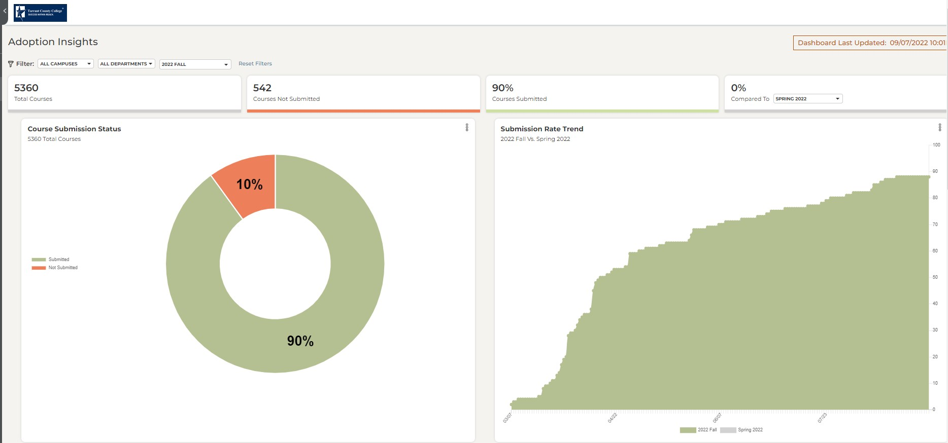
Dashboards – Run CWOB

Slide 72
Dashboards – Run Adoption Reports

Slide 73
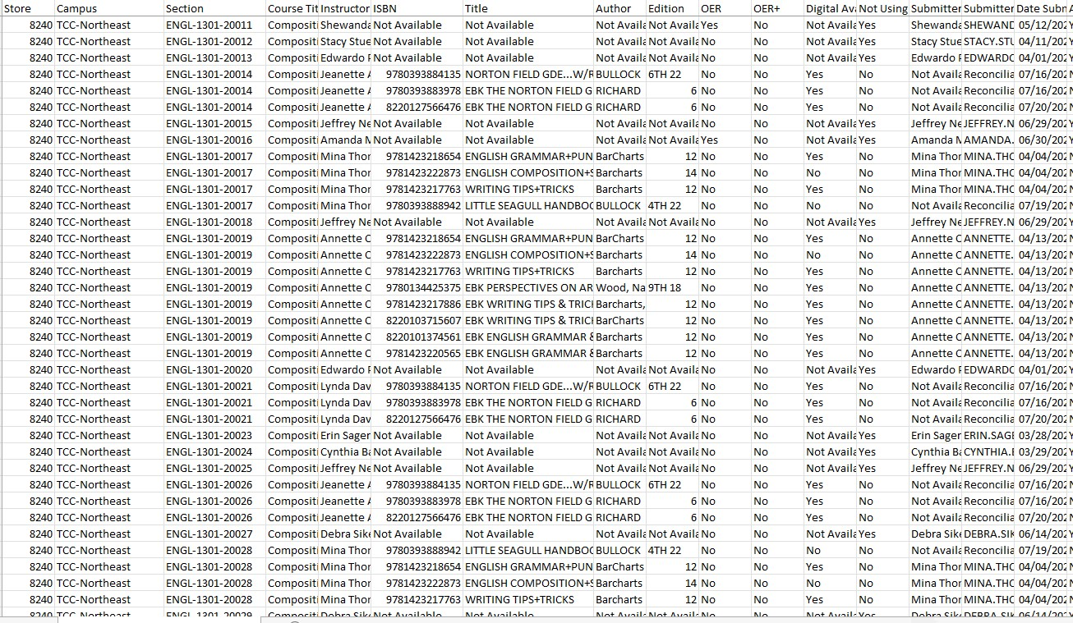
Dashboards – Review for DE Sections

Slide 74
Steps to Obtain DE Course Materials
Faculty Assignments
Course Material Adoptions
Utilize AIP Dashboards and/or Bookstore Website to Determine Course Material Needs
Submit Course Material Quote Request to Campus Bookstore for Bulk Purchases
Use Bookstore Quote to Request a PO from ISD
Course Materials Charged and Available for Pickup after PO received

Slide 75
Resources:
Student Learning Materials
slm@tccd.edu
Adoptions Insight Portal (AIP)
InsideTCC
Faculty Resources
Bookstore Website
Tccd.bncollege.com
TCCD B&N Bookstores:
South/Connect sm8242@bncollege.com
Trinity River sm8243@bncollege.com
Northwest sm8244@bncollege.com
Northeast sm8240@bncollege.com
Southeast sm8241@bncollege.com

Slide 76
Thank you

